Slide 1
FSSC 24000:
From Risk to Opportunity
9 October 2024

Slide 2
Introduction to fssc

Slide 3
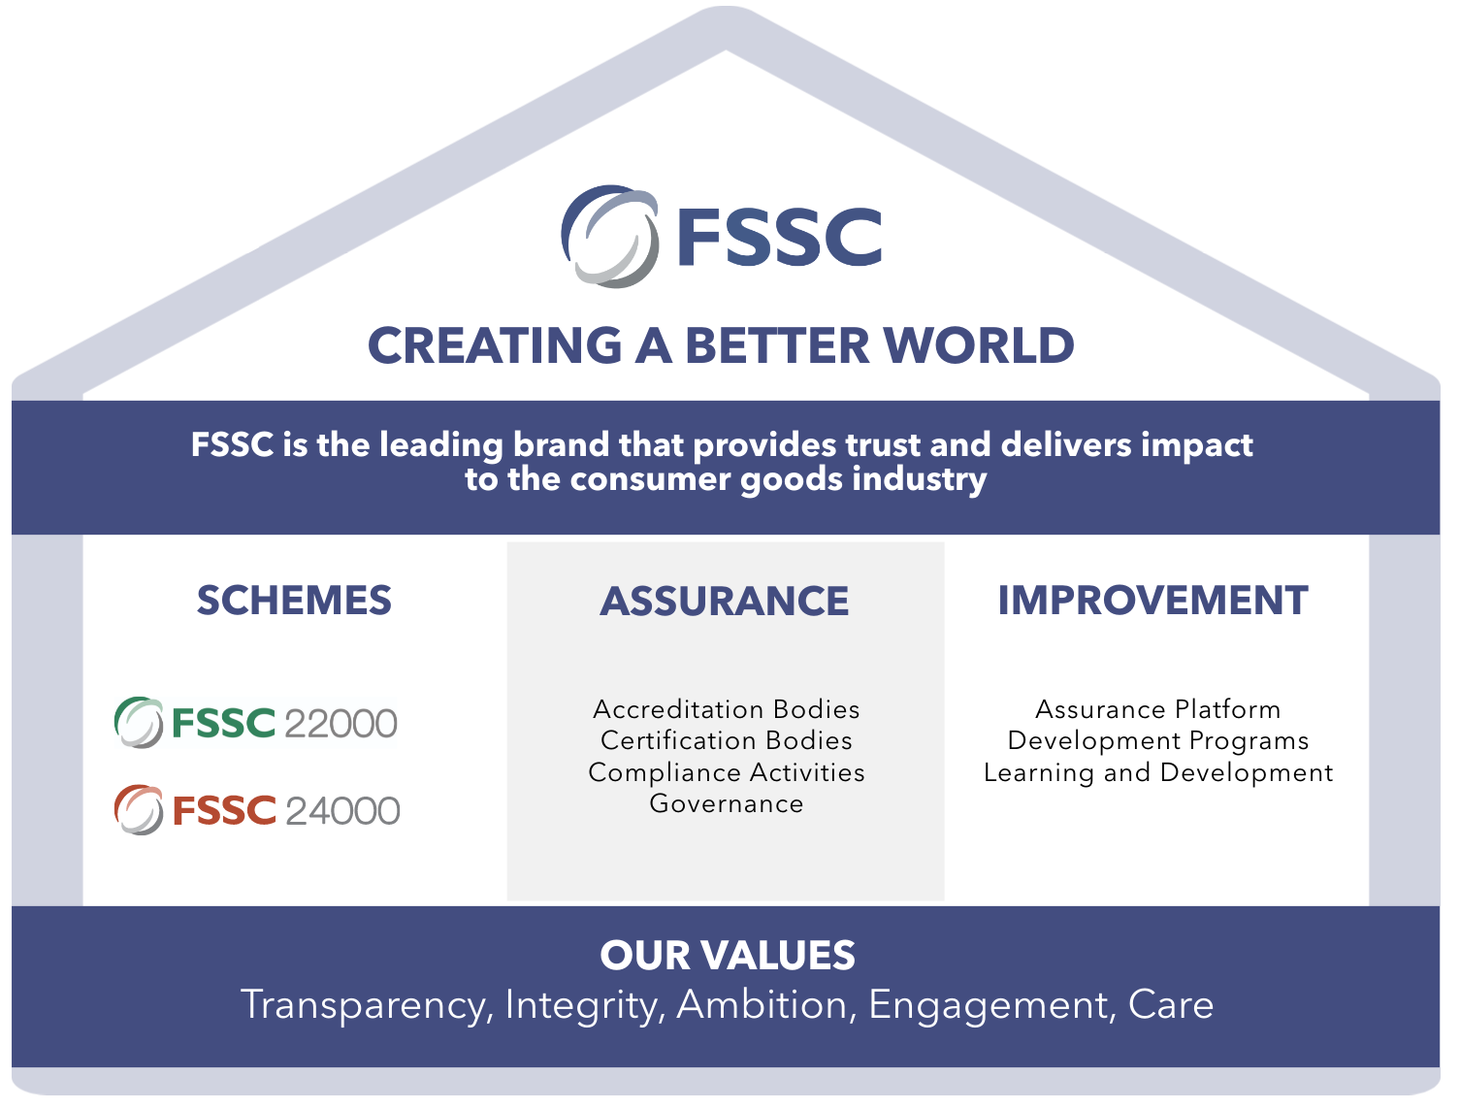
FSSC branded house
Notes:
FSSC is a non-profit organization based in the Netherlands. We are a Scheme owner. This graphic shows what we call our branded house. As every house needs a strong foundation, you will see that our values form the foundation of our house.
Our values include transparency, integrity, ambition, engagement, and care. These values are important for us in everything we do and in our collaboration with others. Then our house has three pillars. The first pillar is our Schemes, including FSSC 24000, as well as our Scheme FSSC 22000, for Food Safety Management Systems.
The second pillar is Assurance. Reliable certification and audits are very important, and we have an integrity program in place to ensure that FSSC audits are delivered to a high quality and provide a high level of assurance to the consumer goods industry. Together with our partners, such as Certification Bodies and Accreditation Bodies, we ensure that FSSC audits are delivered to a high quality and provide a high level of assurance to the consumer goods industry.
Our third and final pillar is improvement, as continuous improvement is a must for our organization. Then, it all leads upwards to supporting the brands and, together with us, creating a better world.

Slide 4
the social risk component

Slide 5
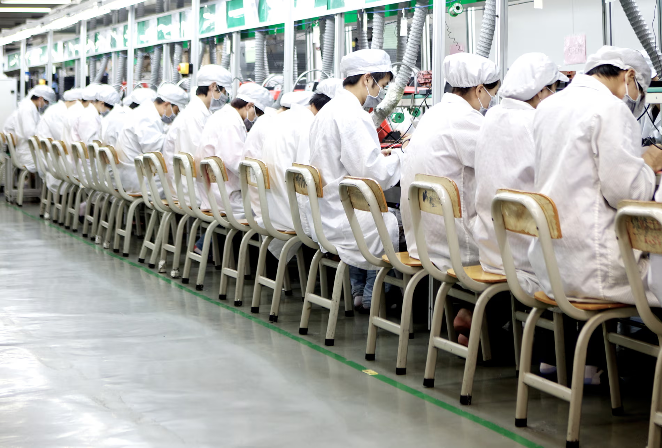
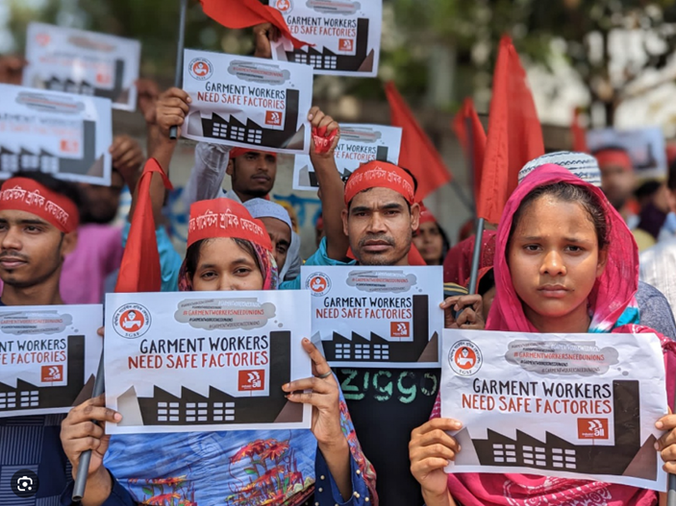
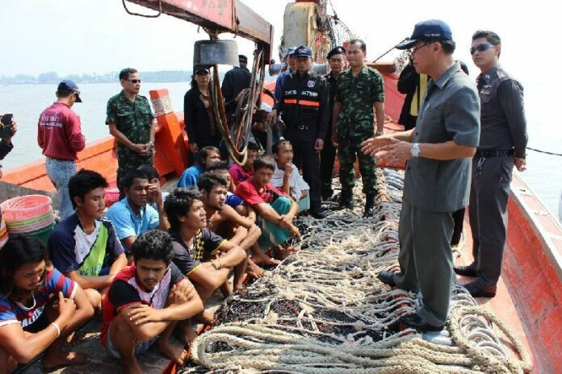
HOW Social risks inside and outside of your company may affect you
Conditions of work within factories (Foxconn – 2010), or harassment (France Telecom 2009)
Building safety in the supply chain (Rana Plaza disaster - 2013)
Forced labor in the supply chain
(Fisheries in Thailand - 2014)
Resulted in new legislations and regulations
Notes:
In order to understand the social landscape better, we need to go back and understand some of the events that have shaped it and contributed to where we are today. In 2010 there was the Foxconn scandal where workers were living in bunks of a few square meters, eating and living inside the factories, doing exhausting shifts. This led to a wave of suicides in its Chinese factories.
The Rana Plaza disaster occurred in Bangladesh, on 24 April 2013. 1100 people lost their lives. The disaster had worldwide visibility, demonstrations, and impact; and as a result local and other countries' laws have changed.
The Thai seafood industry employs more than 800,000 people, while seafood exports are valued at $6 billion. A growing number of independent reports over the past decade have documented abuses of workers tracked onto Thai fishing vessels, including bonded, forced and slave labor,
Unfortunately, these type disasters were needed to highlight the need for safer working conditions and the importance of managing social risks throughout the supply chain. These are just 3 examples, but sadly, similar activities still take place today, across the globe. And whilst it might not be happening in your organization, what happens in your supply chain can have a direct and significant impact on your organization and how it is perceived.

Slide 6
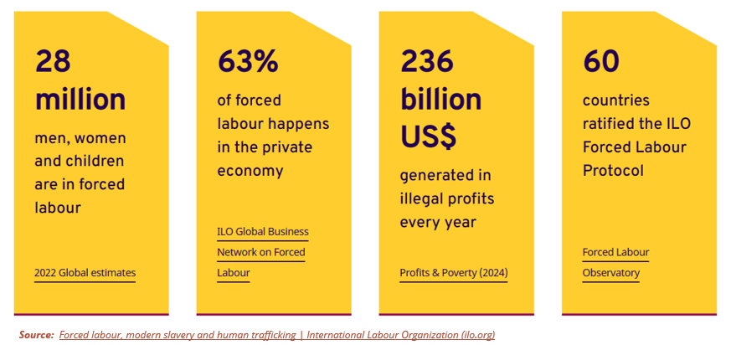
Facts and figures
Notes:
Even today there is still a shocking amount of forced labour taking place – according to the ILO publication on forced labour, modern slavery and human trafficking, there is still 28 million people working as forced labour, and 63% of this happens in the private economy. As a result the ILO Forced labour protocol was established.

Slide 7
EVOLUTION OF REGULATORY CONTEXT
The responsibility of enterprises is extended down to the customers and out to all suppliers. Legislation increasingly incorporates concepts and principles of "universality". Areas involved include bribery and corruption, money laundering and terrorism financing, human rights across the supply chain, and compliance with economic and trade sanctions. | European Union's new Directives require new laws in all EU countries, related to: ESG Reporting (active from 2023) Corporate sustainability reporting - European Commission (europa.eu) ESG Due Diligence (active from 2027) Rules enforcing rights and environmental sustainability (europa.eu)
 | Canada's BILL S-211: Fighting Against Forced Labour and Child Labour in Supply Chains: Public Bill (Senate) S-211 (44-1) - Third Reading - Fighting Against Forced Labour and Child Labour in Supply Chains Act - Parliament of Canada
Notes:
The other aspect that has evolved, is the regulatory context. The responsibility of enterprises is extended down to the customers/end users and out to all suppliers
Legislation incorporates the concepts and principles of “universality.” Areas involved include Bribery and Corruption, Money laundering and terrorism financing, Human Rights across the supply chain, and Compliance with economic and Trade Sanctions.
European Union’s new Directives require new laws in all EU countries to be implemented , related to
ESG Reporting (active from 2023)
Corporate sustainability reporting - European Commission (europa.eu)
ESG Due Diligence ( active from 2027)
Rules enforcing rights and environmental sustainability (europa.eu)
Canada’s BILL S-211: Fighting Against Forced Labour and Child Labour in Supply Chains
Public Bill (Senate) S-211 (44-1) - Third Reading - Fighting Against Forced Labour and Child Labour in Supply Chains Act - Parliament of Canada
These regulations require a risk assessment of the organization and its supply chain, and a management system for environmental and social sustainability. This includes a mechanism to manage risk, monitor it and report on it.

Slide 8
TACKLING ESG issues
Environmental, Social and Governance (ESG) issues are the core of the Sustainability concept.
  Sustainability is only complete if you consider the financial, environmental and social impacts of a company.
Measure of risk differs for each business
  First not delivering on objectives
  Social impact:
    On employees, community and overall society
    Reporting based on legislation
    Broader concept of supply chain management
    Reputational risk
Notes:
Maybe you think: why is all of this relevant to us? As you are all aware, sustainability is top of mind and has also been taken up in the UN SDGs. ESG issues are at the core of the sustainability concept, and sustainability is only complete if you consider the financial, environmental and social impacts of a company.
However, the measure of risk and the appetite for risk differs for each business. The first and obvious risk for any business is not delivering on its objectives. The social component goes a step further and looks at the impact on employees, the community you operate in, as well as the overall society. There are new reporting requirements based on legislation, and the broader concept of supply chain management, as well as reputational risk for the organization.

Slide 9
Social issues
There is a more significant emotional impact as the public reacts strongly to social scandals. The evolution of society and ethics sets less tolerance for these.
The effect on a company's reputation is the greatest.
Social issues are difficult to foresee as they may affect situations beyond your own company. The public will also associate your name with what your co-packers, co-manufacturers, and providers may do.
Your supply chain is one of the major risks.
Notes:
When we look at social issues, and the evolution of society, people are far less tolerant, and the public reacts strongly to social scandals. It is an emotional topic and if something goes wrong on the social front, it can have a significant impact on the company’s reputation. It is also very difficult to recover from such events.
Social issues are difficult to foresee, and it might also include situations beyond the control of the company. This is where your supply chain is one of the major risks, due to the public associating your name with what happens in the supply chain.

Slide 10
Social Compliance – Market drivers
Compliance with international due diligence requirements in the Social supply chain
Supply Chain Management SDGs ESG Risks NGO’s Consumer Goods Forum Coalition of Action for Sustainable Supply Chain Initiative (SSCI) IAF-MLA | External Stakeholders
Regulatory | Laws to ensure responsible business practices and take action to respect human rights: EU CSRD Germany's new Supply Chain Due Diligence Act UK Modern Slavery Act California Supply Chain Transparency Act Australian Modern Slavery Act
SUPPLY
CHAIN
ESG Green Investments Good Governance Cultural Consequences Social Media Brand Image | Investors/ Insurance
Integrated Management Systems | Harmonized Structure Reduction in the number of audit events Integrated / Combined Audits Effective audit strategy

Slide 11
SOCIAL COMPLIANCE DRIVERS
Society at large is less tolerant of abuses, bad working conditions, corruption etc.
Increasing external demand to govern social aspects
and ensure good practice.
Legislators follow societal pressures to respond to new ethical requirements.
Peers can use good practices as differentiating factors.
NGOs and activist investors add to social pressure.

Slide 12
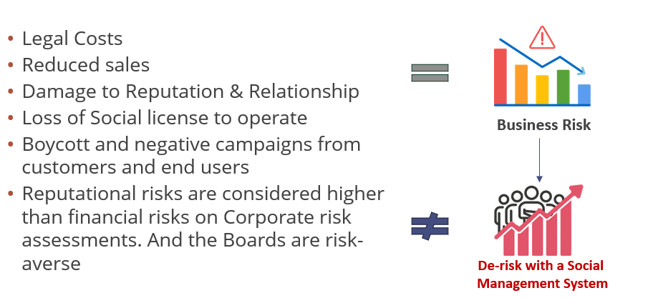
Cost of ignoring social risks
Notes:
Ignoring social risks could have the following impact on your business:

Slide 13
What are the FSSC 24000 Opportunities?

Slide 14
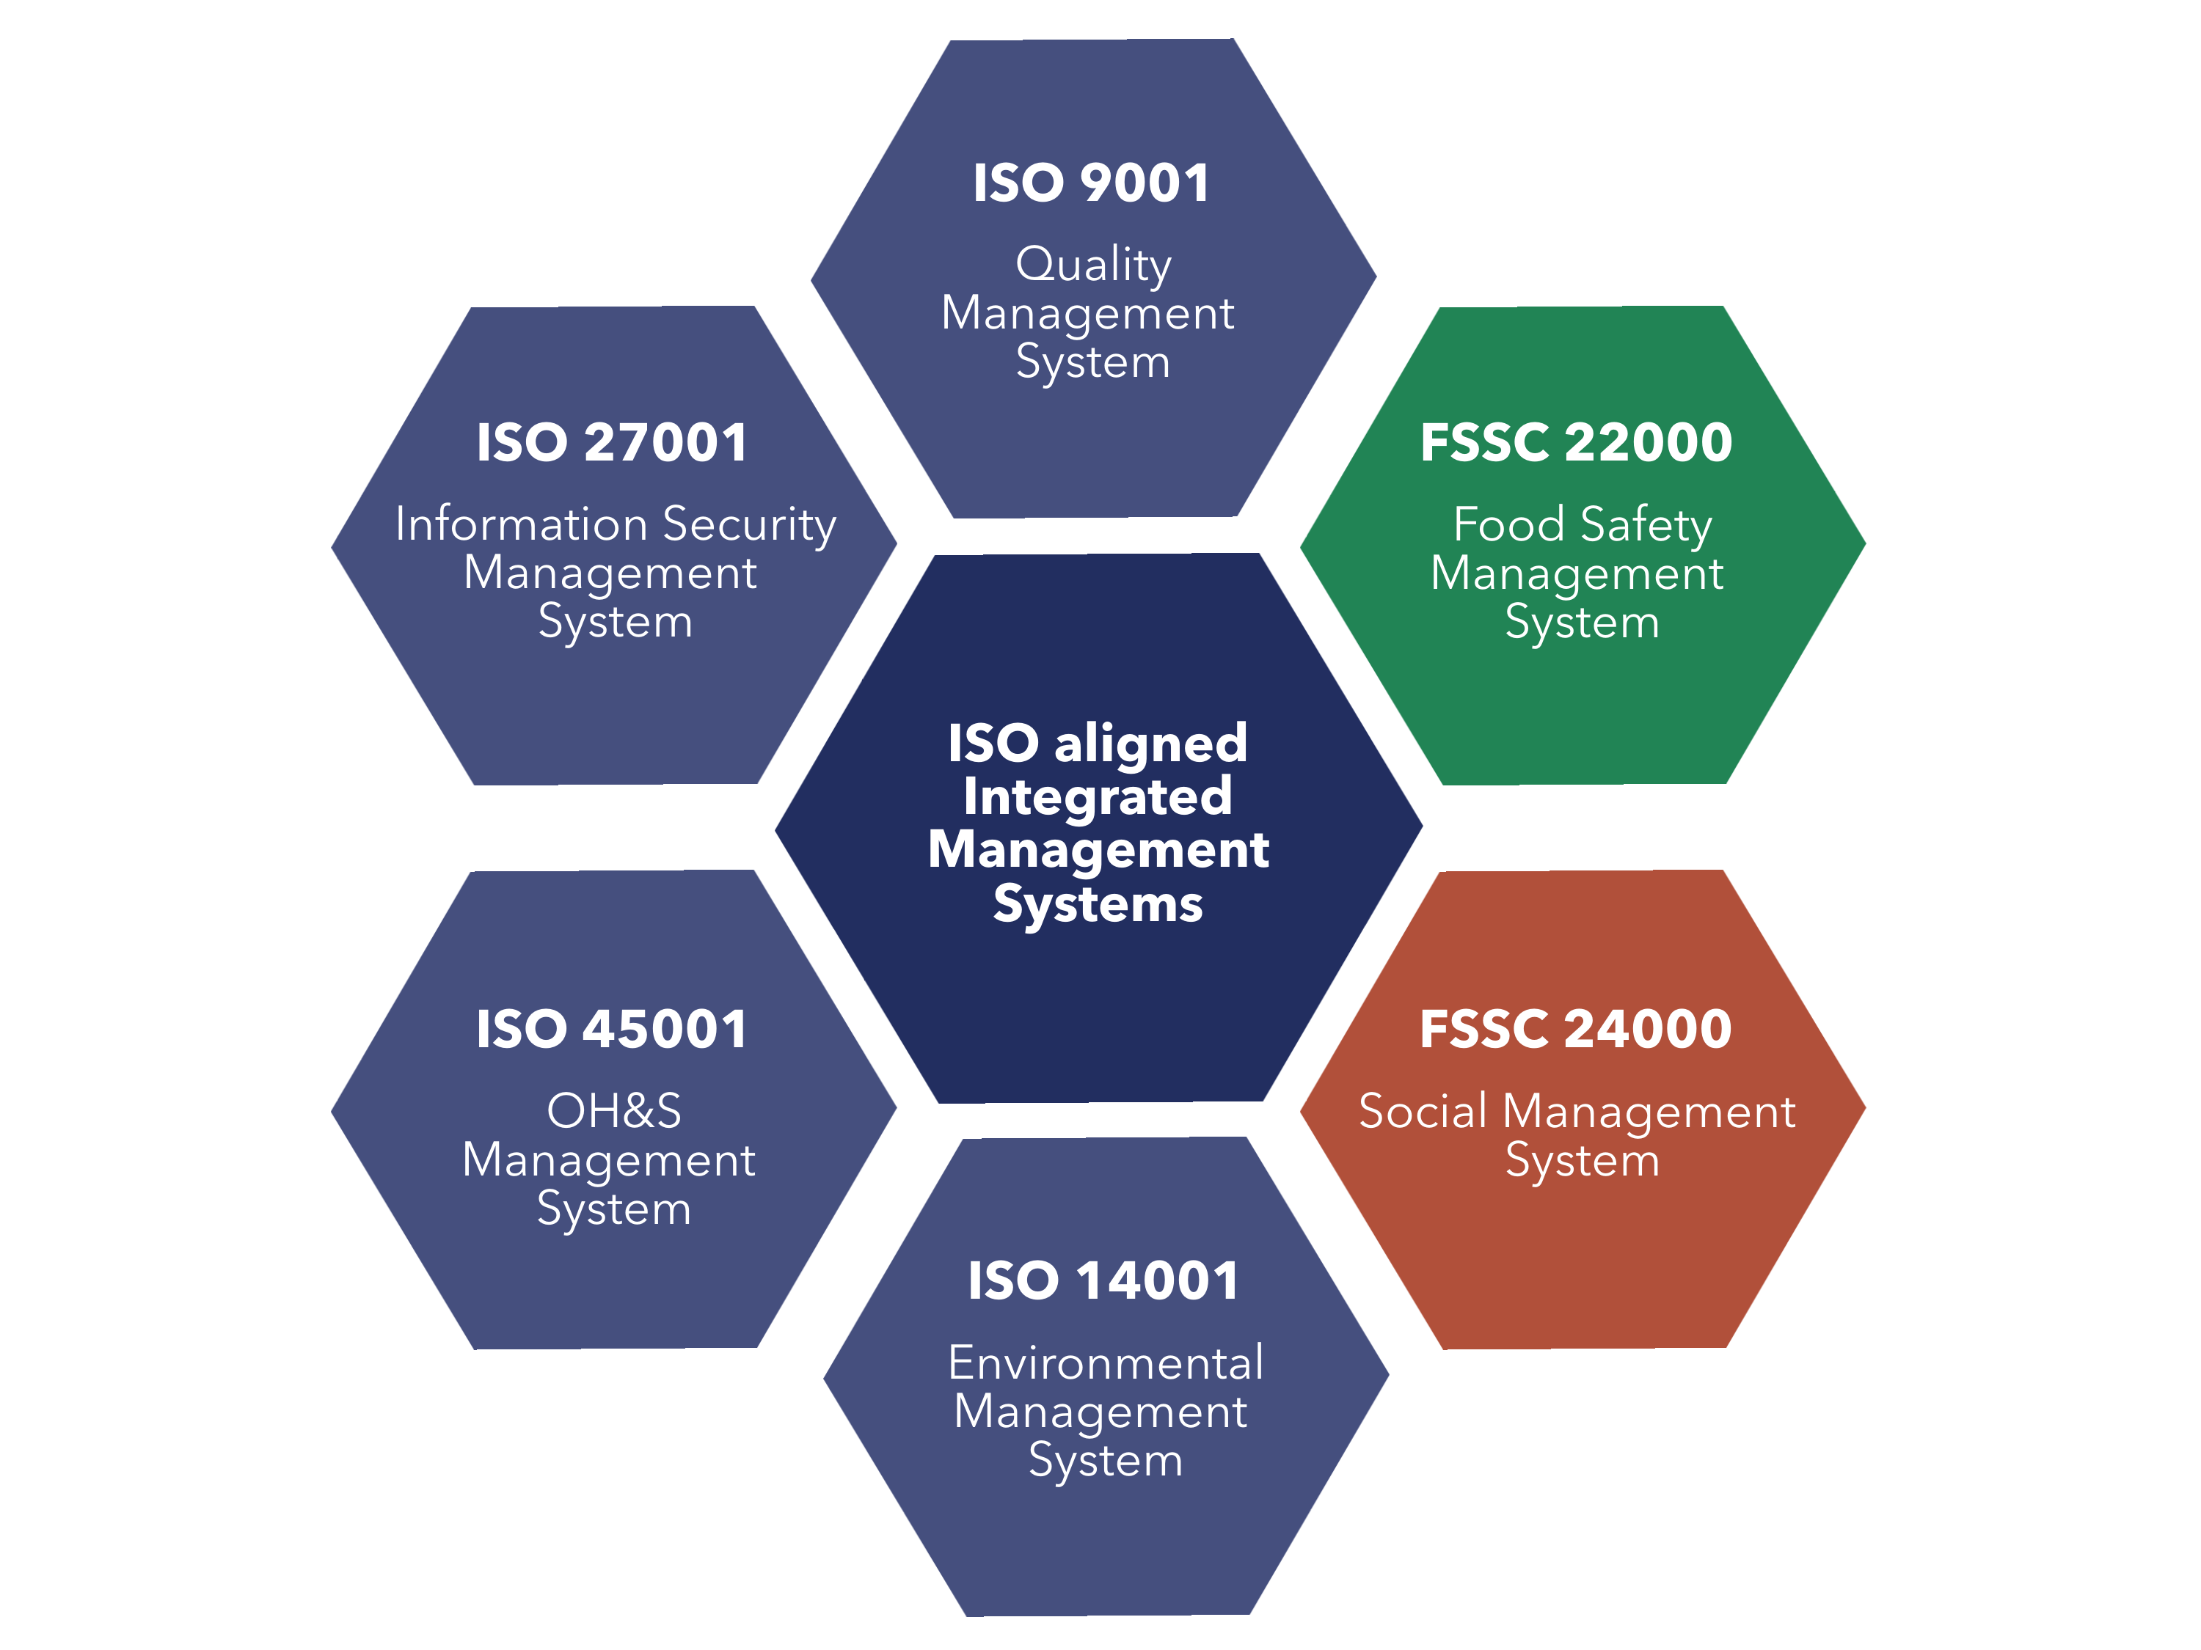
ISO MANAGEMENT SYSTEMS
FSSC 24000 is aligned with the ISO Management System approach and the ISO Harmonized Structure, which facilitates integration with other ISO management standards.
Organizations can leverage their expertise on other ISO norms to deploy FSSC 24000 into their business in harmonized way.
Foundation FSSC is a proven expert in F&B with FSSC 22000. FSSC Integrity Program applies to FSSC 24000 as well.

Slide 15
ISO HARMONIZED STRUCTURE
ISO Management System standards help structure, focus, and drive continuous improvement in an organization – resulting in a high-impact management system.
ISO management principles ensure a robust and effective integrated management system.
6.1.2
Plan actions
4.1
External Issues
6.1.1
Risks & Opportunities
9.3.3, 10.2, 10.3
Review and improve
8.1
Integrate in SMS
4.1
Internal Issues
4.2
Interested Parties
4.2
Requirements
9.1
Evaluate
Notes:
Identify and assess through the risk assessment – include working conditions, H&S, Human rights, and Business ethics – needs to be embedded in your social policy
Define & agree actions - planning
Communicate and live it by integrating it into the SMS
Reflect, review, evaluate and improve

Slide 16
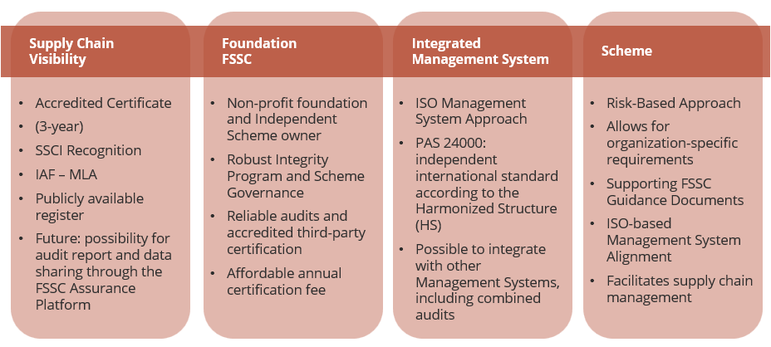
Features and benefits of FSSC 24000
Notes:
Supply Chain Visibility:
Accredited Certificate (3 years)
SSCI recognition (in progress)
IAF – MLA
Publicly available register
Future: the possibility for audit report and data sharing through the Assurance Platform
Foundation FSSC:
Non-Profit Foundation
Robust Integrity Program and Scheme Governance
Reliable audits and accredited third-party certification
Affordable annual certification fee
Integrated Management Systems:
ISO Management System Approach
PAS 24000: independent international standard according to the Harmonized Structure (HS)
Possible to integrate with other Management Systems, including combined audits,
Scheme:
Risk Based Approach
Allows for customization to add organization-specific requirements
Supporting FSSC Guidance Documents
Organizations used to work with ISO-based management systems are likely to experience a smooth implementation of the management principles of the scheme
Facilitates supply chain management through responsible social procurement and due diligence processes

Slide 17
TOPICS OF PAS 24000 (APPENDIX A)
Human Rights | Building Safety
Forced Labour | Working Hours
Child Labour | Business Ethics
Freedom of Association | Grievance Mechanisms
Discrimination & Fair Treatment of Workers | Employment & Contractual Relations
Occupational Health & Safety
Aim is to provide safe and fair working conditions, apply good business ethics, and due diligence in the supply chain through social procurement
Notes:
Aim is to provide safe and fair working conditions, apply good business ethics, and due diligence in the supply chain

Slide 18
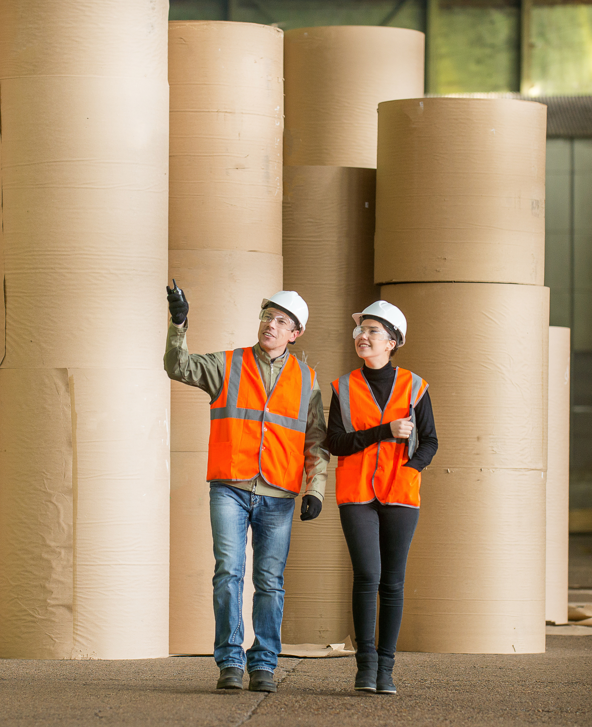
Position social sustainability as an opportunity
Being FSSC 24000 certified will help satisfy the social requirements of legislations such as the Canadian Law S-211 and the European Union, both CSRD and CSDDD.
Future laws worldwide will mimic these; some are already at work. Most are based on the ISO approach.
Differentiate from the competition and positively impact your team by getting certified.
Harness the power of the ISO management system approach and integrated systems

Slide 19

Esg & reporting
Markets & Legislation
EsG is integral to how you run your operations, serve your customers, and develop your people.
Customers & supply chain
ESG is integral to how you run your operations, serve your customers, and develop your people.
People & Communities
Externally verified
Notes:
Meet and exceed stakeholder needs and requirements. SSCI benchmarking provides gateway for market acceptance.
The management system, that has the PDCA cycle embedded provides solid platform to address changes in legislation, e.g. reporting actions on ESG
People needs to be at the heart of what you do, they need to be represented and involved in the business – it is part of maintaining involvement and a health culture in your business
It goes broader than your organization and its people as well – also reflect on how the local community is impacted, and the larger supply chain.
Cross-functional effort focused on continuous improvement
ESG externally verified – independent, accredited third party certification – provides credibility and trust – could lead to reduced supplier audits

Slide 20



Fssc in practice
The Risk-based approach delivers new insights
Brings new challenges, so be prepared & embrace change
Requires collaboration across functions in the business
Integration in business
E S G
ISO 140001 FSSC 24000 ISO 9001
Requires continuous improvement - the journey never stops; you need to keep doing it!

Slide 21

DUE DILIGENCE OBLIGATIONS
FSSC 24000 provides for integrated, reliable, and appropriate due diligence processes for governing supply chain management. It targets an organization’s social and human rights aspects by setting policies, procedures, and risk assessments on a social management system.
FSSC 24000 is the only social certification Scheme currently available that offers the ISO approach to addressing human rights, ethical business conduct, and social topics.
Through monitoring, measuring, analyzing, and evaluating the management system’s performance, organizations will be able to obtain the required data to support transparent and continuous reporting on sustainability and social performance. It covers human rights and social issues in the supply chain (as needed for the Corporate Sustainability Reporting Directive).
In implementing the FSSC 24000 Scheme, the continuous improvement process of an ISO-aligned management system will enable organizations to identify long-term actions that satisfy the social performance expectations mandated by legislation.

Slide 22
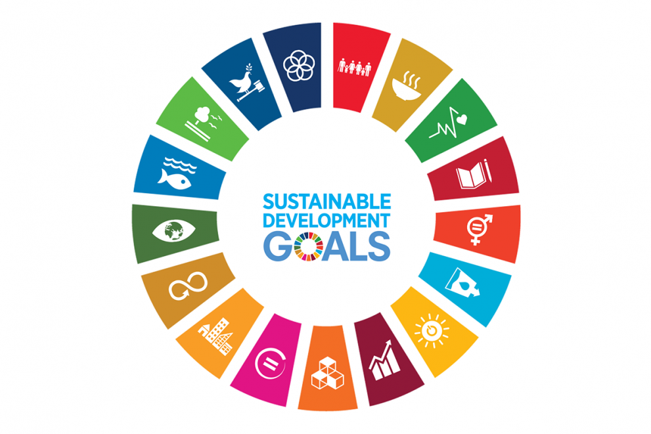
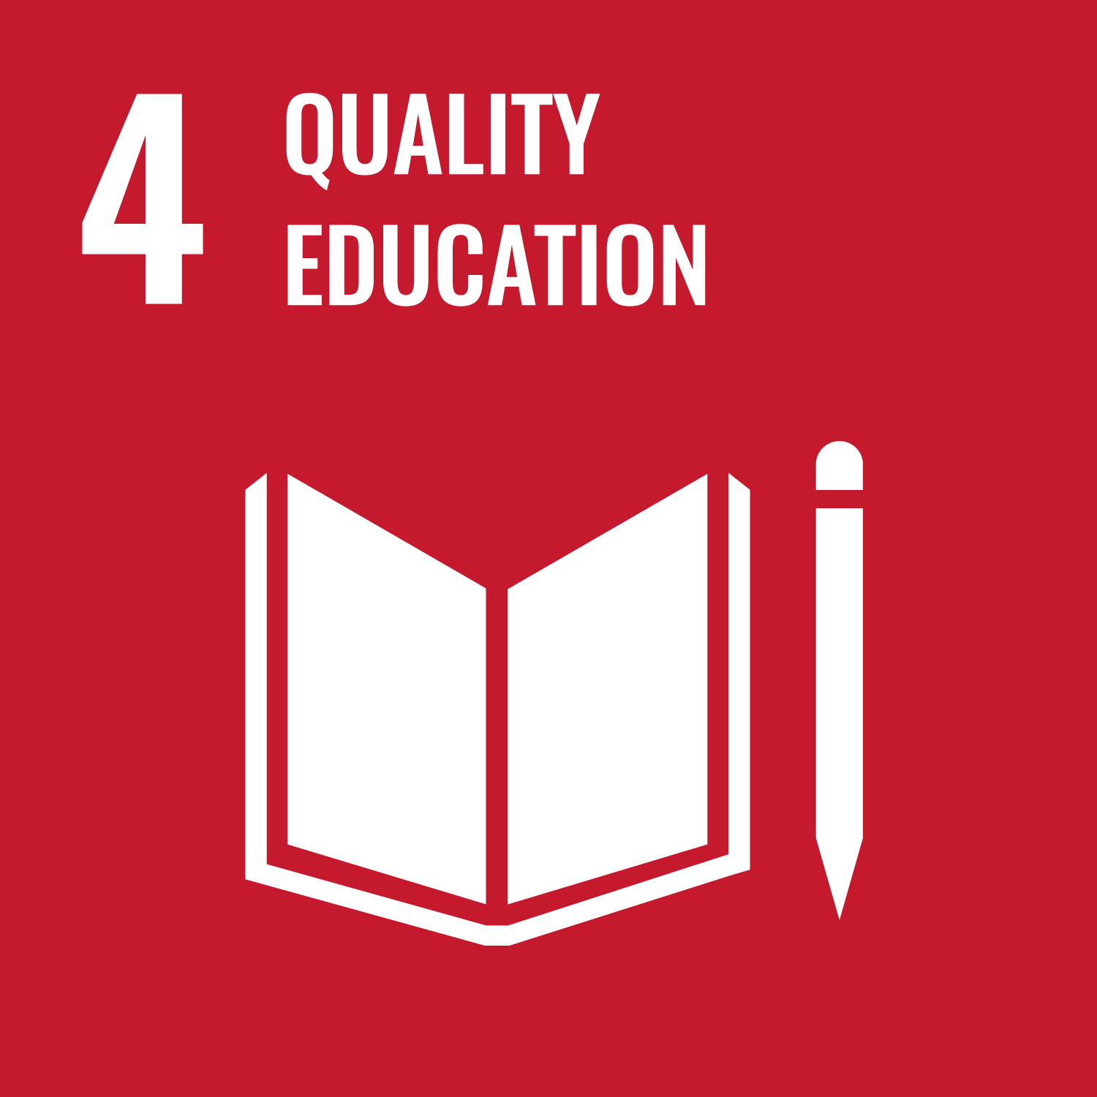

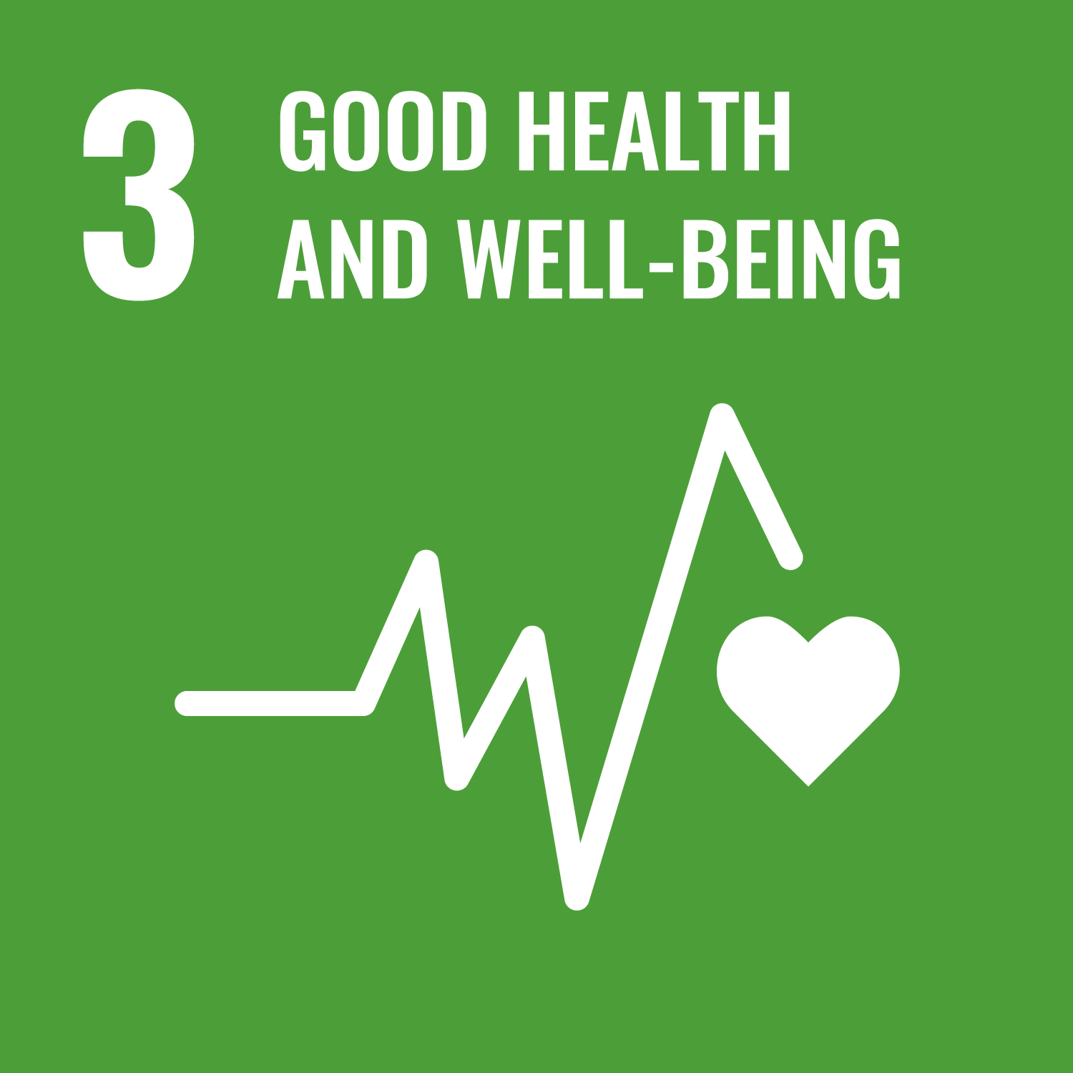
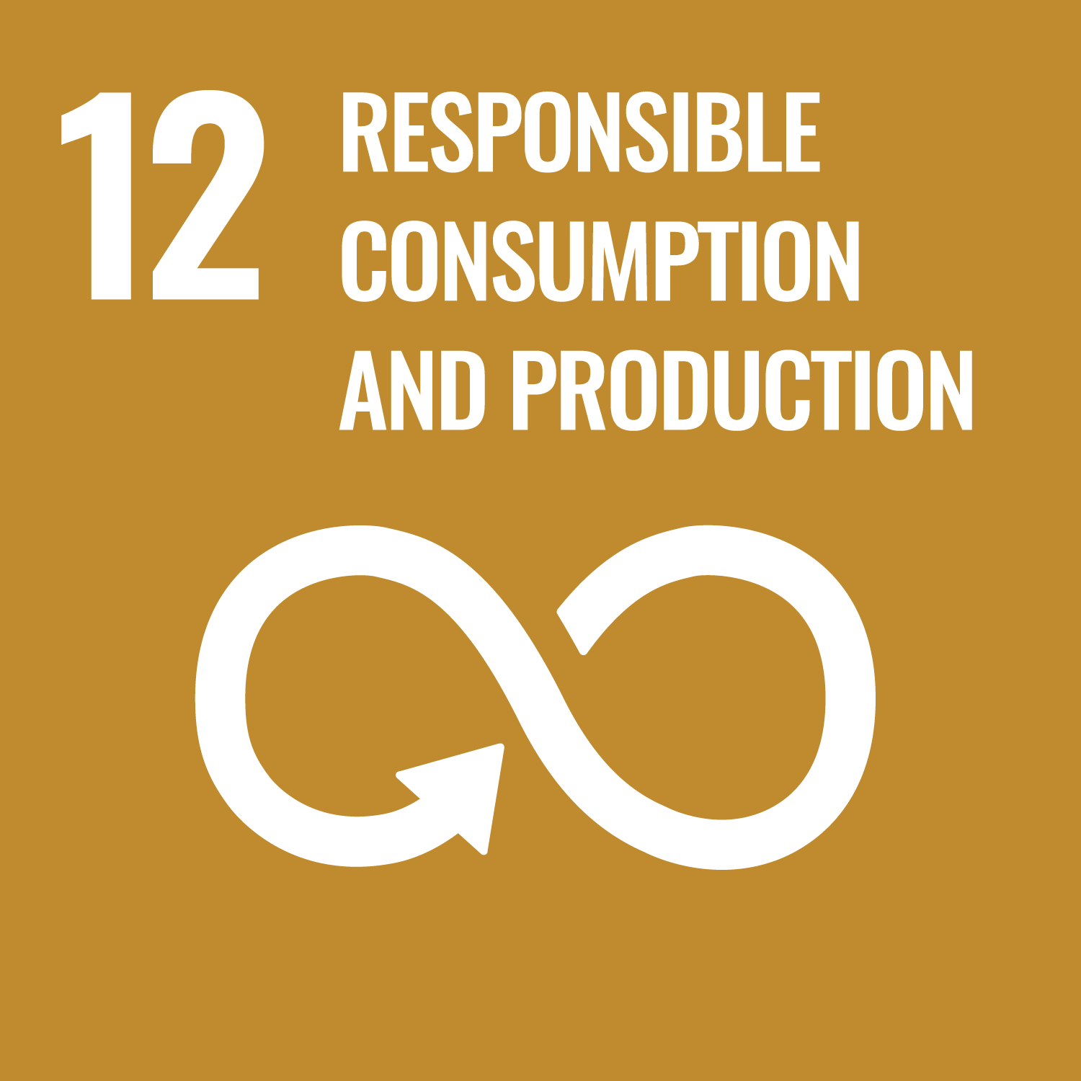

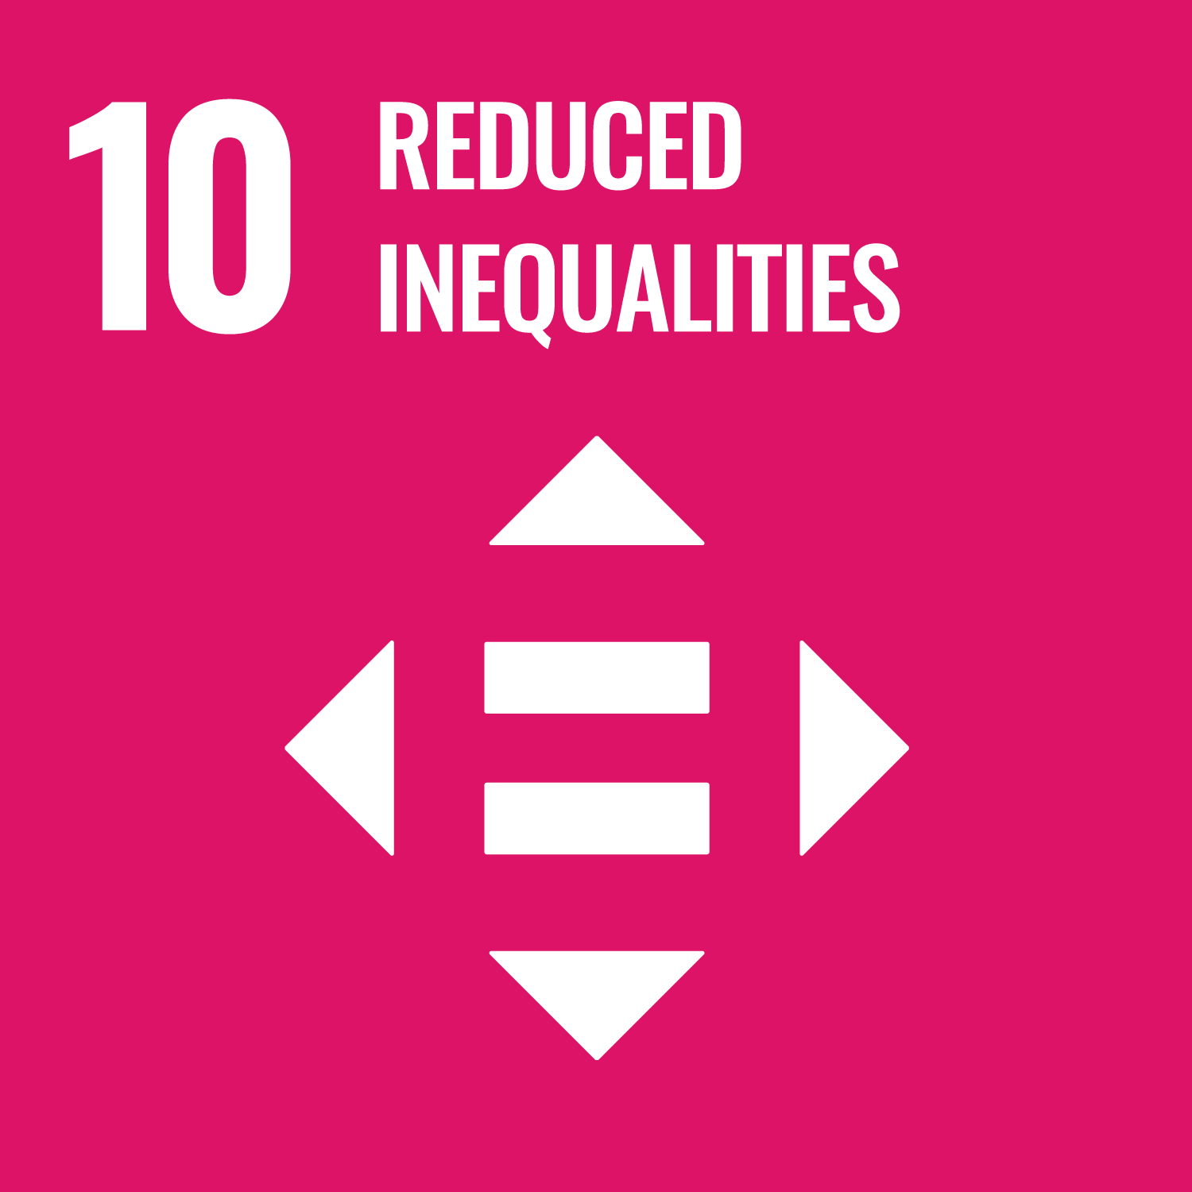
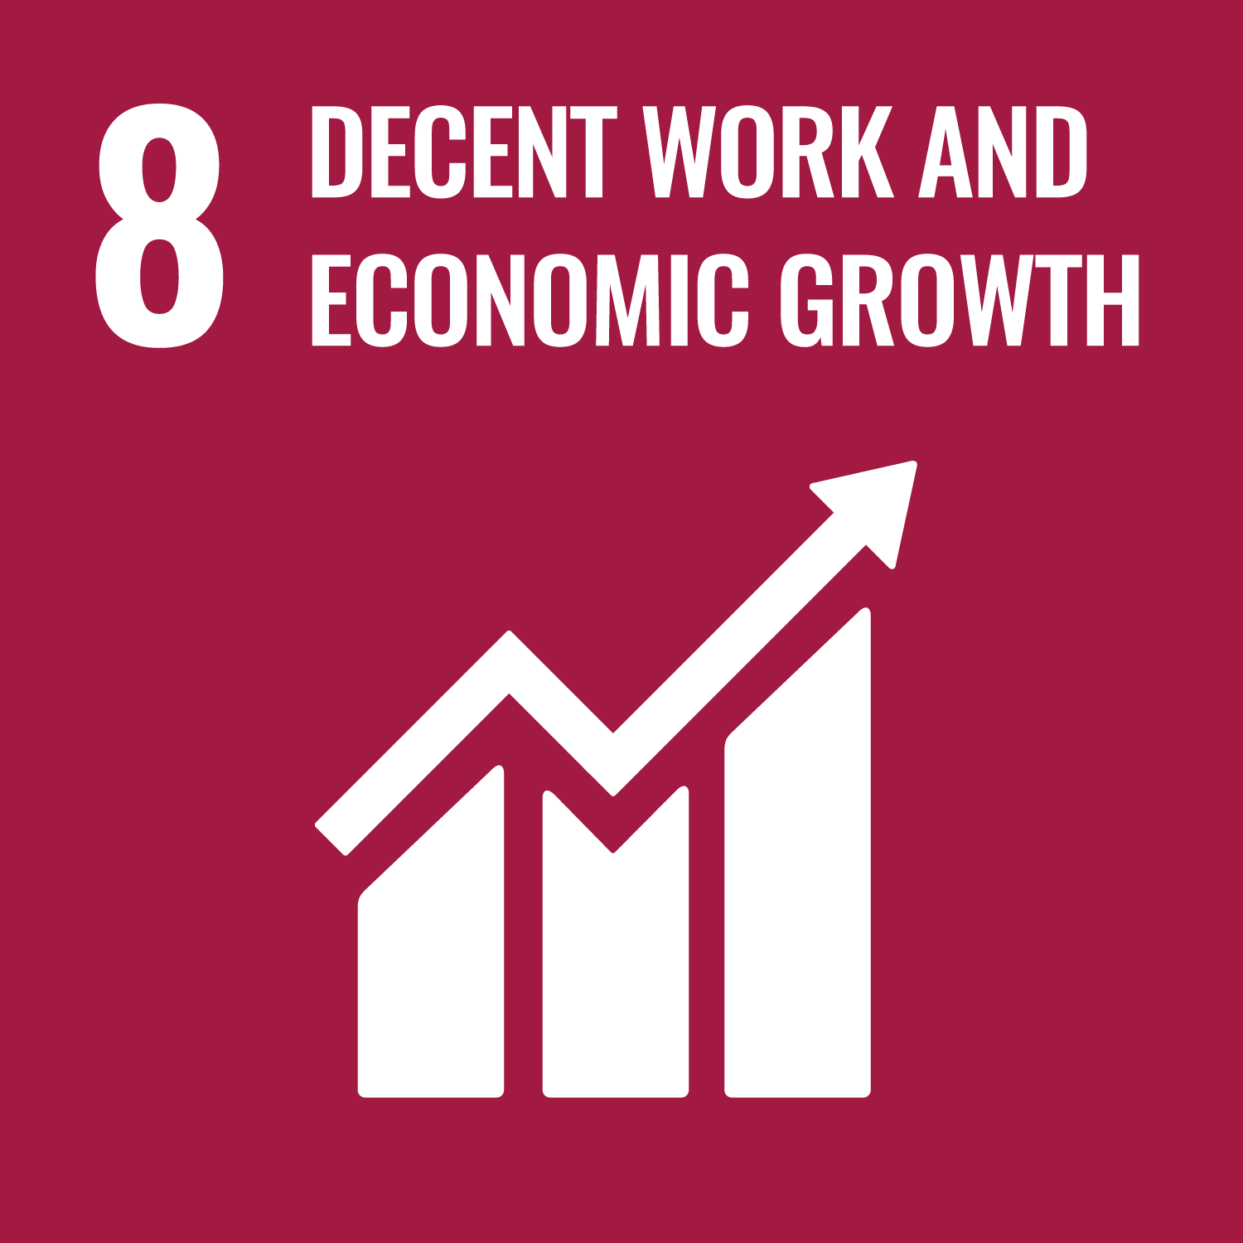
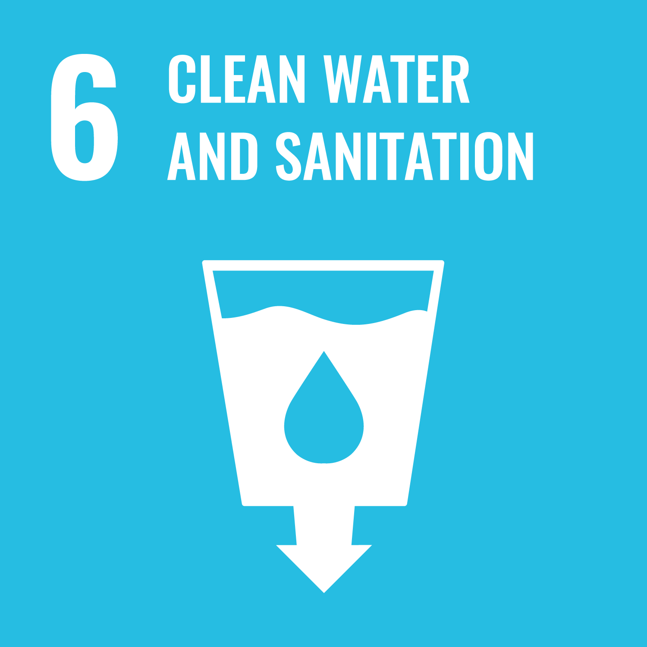
DOING WHAT IS RIGHT
Notes:
FSSC 24000 can have a positive effect on the following SDG's:
SDG 3 - Health and Wellbeing,
SDG 4 – Quality Education,
SDG 5 - Gender Equality,
SDG 6 – Clean Water and Sanitation,
SDG 8 - Decent Work Conditions,
SDG 10 - Reduced Inequalities,
SDG 12 - Responsible Production,
SDG 16 - Peace, Justice, and Strong Institutions (all matters related to Compliance and Governance are included in that SDG).

Slide 23
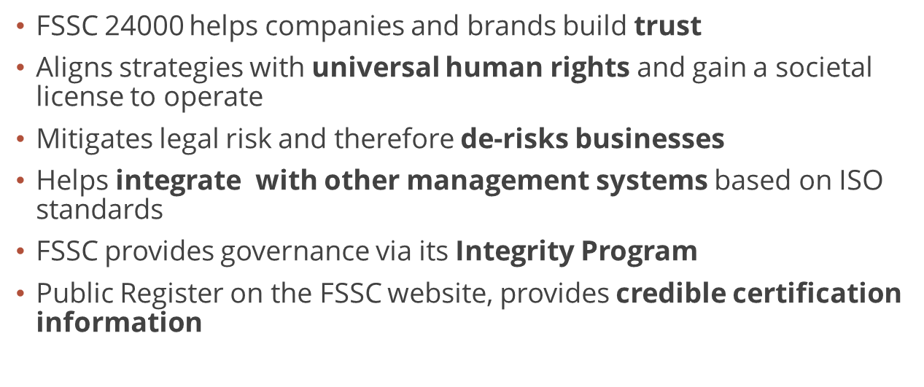
IN SUMMARY

Slide 24
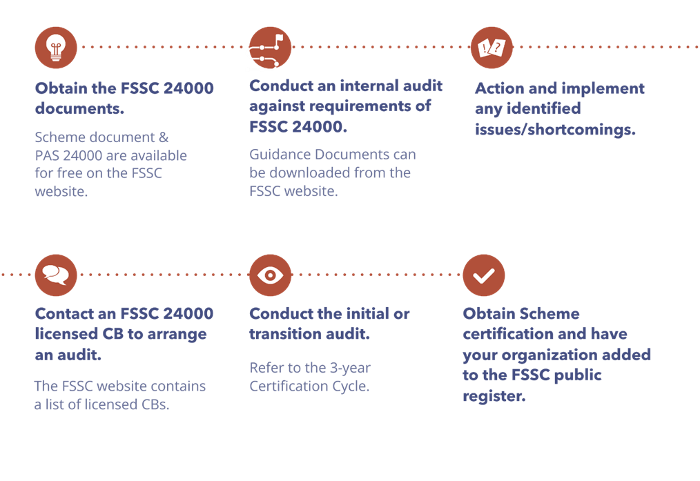
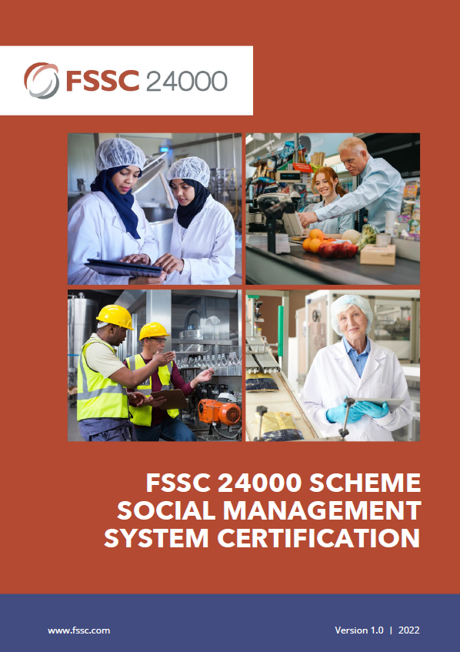
HOW TO OBTAIN CERTIFICATION
Notes:
. Obtain the FSSC 24000 documents - website
Scheme document & PAS 24000
Conduct internal audit against requirements of FSSC 24000
Also refer to the Guidance documents on the FSSC website
Action and implement any identified issues/shortcomings
Contact an FSSC 24000 licensed CB to arrange audit– refer website
Conduct initial or transition audit – see certification cycle
Obtain certification and be displayed on FSSC public register

